Slide 1

CSE
Project
Online
Examination
Analytics Tool
COMPUTER SCIENCE & ENGINEERING — ACADEMIC PROJECT
Team Members
Team Members
2510030089 M. Susanth | 2510030185 V. Sai Sahith
30046 P. Revanth | 30047 N. Sakshith

Slide 2


Problem
Statement
Traditional exams only provide final marks with limited learning insights. Faculty spend significant time manually analyzing student performance across large cohorts, making it difficult to identify trends or intervene early.
Students receive only scores without detailed feedback on their strengths or weaknesses, leaving them unable to effectively target areas for improvement.
There is a pressing need for an intelligent platform to automate performance analysis, deliver meaningful data visualizations, and support data-driven academic decisions for both students and faculty.

Slide 3





Centralized Platform
Objectives
Detailed Analytics
Design a centralized platform for exam data management and streamline access for students and faculty. Generate detailed analytics reports to help students understand strengths and weaknesses. Classify performance by subjects and topics for targeted academic improvement.
Performance Classification
Visual Reports
Support institutions in improving learning outcomes. Provide visual reports for simplified academic analysis. Reduce manual effort in exam report preparation.

Slide 4




Technology
Stack
Frontend
Backend
Development Tools:
Visual Studio Code — primary IDE for coding and debugging.
GitHub — version control and collaborative development.
Matplotlib — data visualization and chart generation library.
Database
Visualization

Slide 5


Expected
Centralized Exam Database
A unified platform stores all exam data securely, enabling instant analytical reports post-exams and interactive dashboards that visualize student performance trends across subjects and topics.
Outcome
100%
60%
3x
Faculty evaluate class performance efficiently. Students gain clear insights into academic progress. Improved accuracy and reduced manual effort in exam result analysis.
Automated Reports
Time Saved
Faster Analysis

Slide 6


Project
Modules
Student Module
Faculty Module
Overview
Registration & Login, Attend Exams, View Results, Performance History, Individual Feedback Reports.
Create & Schedule Exams, Manage Question Banks, Review Performance, Generate Reports, Monitor Progress.
Analytics Module
System Features
Subject & Topic-wise Analysis, Student Ranking, Score Distribution, Difficulty Analysis, Interactive Dashboard.
Automated report generation, data visualization with charts, role-based access control, and real-time performance insights.

Slide 7
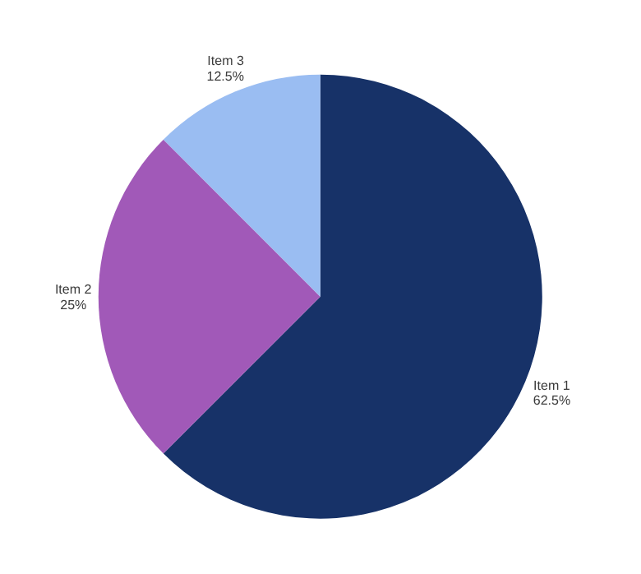


Project
Plan
Phases 1–4
Phases 5–6
Weeks 1–2: Requirement Analysis & System Design. Weeks 3–7: Module Development & Integration. Weeks 8–10: Testing, Bug Fixes, Documentation & Final Presentation.

